Slide 1

Computer Communications
& Networks
CSNC-2413
Week: 12
Computer Networking:
A Top Down Approach
6th edition
Jim Kurose, Keith Ross
Addison-Wesley
March 2012
Ch 4 : Network Layer
Dr Nauman Mazhar
Faculty of Information Technology (FIT)
University of Central Punjab (UCP)

Slide 2
Chapter 4: outline
4.1 introduction
4.2 virtual circuit and datagram networks
4.3 what’s inside a router
4.4 IP: Internet Protocol
  datagram format
  IPv4 addressing
  ICMP
  IPv6
4.5 routing algorithms
  link state
  distance vector
  hierarchical routing
4.6 routing in the Internet
  RIP
  OSPF
  BGP
4.7 broadcast and multicast routing

Slide 3

















Network layer
application
transport
network
data link
physical
transport IP pkts from sender to receiver host
sending side:
encapsulate segments into
IP pkts
receiving side:
extract segments from IP pkts, deliver to transport layer
network layer protocols:
help move IP pkts thru the N/W
routers examine header fields in IP pkts (upto N/W layer)
network
data link
physical
network
data link
physical
network
data link
physical
network
data link
physical
network
data link
physical
network
data link
physical
application
transport
network
data link
physical
network
data link
physical

Slide 4

Encapsulation
source
message
M
application
transport
network
link
physical
segment
H_{t}
M
H_{t}
datagram
H_{n}
H_{n}
H_{t}
M
frame
H_{l}
H_{n}
H_{t}
M
link
physical
switch
destination
H_{n}
H_{t}
M
network
link
physical
M
application
transport
network
link
physical
H_{l}
H_{n}
H_{t}
M
H_{n}
H_{t}
M
H_{t}
M
H_{n}
H_{t}
M
H_{l}
H_{n}
H_{t}
M
router

Slide 5
The Network layer
Network layer functions at hosts/routers :
Transport layer: TCP, UDP
IP protocol
addressing conventions
datagram format
packet handling rules
Routing protocols
path selection
RIP, OSPF, BGP
Network
layer
ICMP protocol
error reporting
router “signaling”
forwarding
table
Link layer
physical layer

Slide 6
Two key network-layer functions
Forwarding:
move packets from router input port to appropriate
output port
Routing:
determine the route taken by packets, from source to destination
  run a routing algo
  build routing table
  learn forwarding table
analogy:
routing: process of planning the trip from source to dest
forwarding: process of getting through a single interchange

Slide 7
Interplay between routing and forwarding
routing algorithm
routing algo determines
end-end-path through network
local forwarding table
forwarding table determines
local forwarding at this router
header value
output link
0100
0101
0111
1001
3
2
2
1
value in arriving
packet’s header
0111
1
3
2

Slide 8
Chapter 4: outline
4.1 introduction
4.2 virtual circuit and datagram networks
4.3 what’s inside a router
4.4 IP: Internet Protocol
  datagram format
  IPv4 addressing
  ICMP
  IPv6
4.5 routing algorithms
  link state
  distance vector
  hierarchical routing
4.6 routing in the Internet
  RIP
  OSPF
  BGP
4.7 broadcast and multicast routing

Slide 9
Network layer service model
Connection-oriented or connection-less service
Virtual-Circuit Network :
provides network-layer connection oriented service
(pkts forwarded using virtual circuit numbers)
Datagram Network :
provides network-layer connectionless service
(pkts forwarded using dest IP addr)
Same as TCP/UDP connection-oriented / connectionless service at transport layer, but …
  Service : host to host
  no choice : network provides one or the other
  Implementation : in network core

Slide 10
Datagram networks
Packets forwarded using address of destination host
  No network-level concept of “connection”
  No call setup at network layer
  No state maintained at routers for connections
  each pkt treated independently
application
transport
network
data link
physical
application
transport
network
data link
physical
1. send datagrams
2. receive datagrams

Slide 11
Datagram forwarding table
4 billion IP addrs
does not list individual dest addrs
lists range of IP addrs
(aggregate table entries)
routing algorithm
local forwarding table
dest address
output link
address-range 1
address-range 2
address-range 3
address-range 4
3
2
2
1
IP destination address in
arriving packet’s header
1
3
2

Slide 12
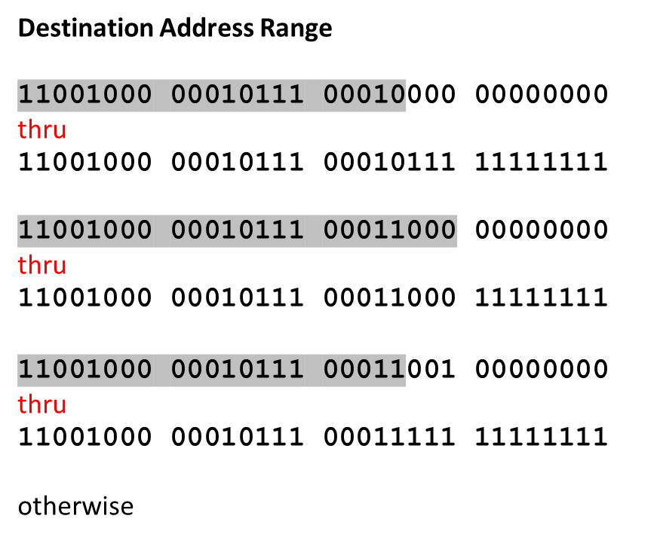
Datagram forwarding table
Link Interface
0
1
2
3
router matches a prefix of pkt dest addr with entries in forwarding table

Slide 13
Longest prefix matching
longest prefix matching
when matching forwarding table entry for given dest addr,
use longest addr prefix that matches dest addr
Destination Address Range
11001000 00010111 00010*** *********
11001000 00010111 00011000 *********
11001000 00010111 00011*** *********
otherwise
Link interface
0
1
2
3
examples:
which interface?
which interface?

Slide 14
Chapter 4: outline
4.1 introduction
4.2 virtual circuit and datagram networks
4.3 what’s inside a router
4.4 IP: Internet Protocol
  datagram format
  IPv4 addressing
  ICMP
  IPv6
4.5 routing algorithms
  link state
  distance vector
  hierarchical routing
4.6 routing in the Internet
  RIP
  OSPF
  BGP
4.7 broadcast and multicast routing

Slide 15
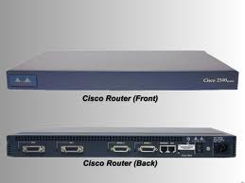

Slide 16
Router architecture overview
Two key router functions:
run routing algorithms/protocols (RIP, OSPF, BGP)
process incoming datagrams, & forward to outgoing links
compute routing/forwarding tables, & push to input ports
routing
processor
router
input ports
high-speed
switching
fabric
router
output ports

Slide 17

Input Port Functions
Physical layer:
reception of bits from signals
Packet forwarding:
for given dest addr, lookup output port in
forwarding table
goal: perform lookup/forwarding at ‘line speed’
if arrival rate faster than forwarding into switch fabric - queuing
Data link layer:
e.g, Ethernet
protocol functions & header removal

Slide 18

Output Ports
(encapsulation)
Queuing required when datagrams arrive from fabric faster than the output data rate
Protocol encapsulation
Conversion of bits into signals

Slide 19
Chapter 4: outline
4.1 introduction
4.2 virtual circuit and datagram networks
4.3 what’s inside a router
4.4 IP: Internet Protocol
  datagram format
  IPv4 addressing
  ICMP
  IPv6
4.5 routing algorithms
  link state
  distance vector
  hierarchical routing
4.6 routing in the Internet
  RIP
  OSPF
  BGP
4.7 broadcast and multicast routing

Slide 20
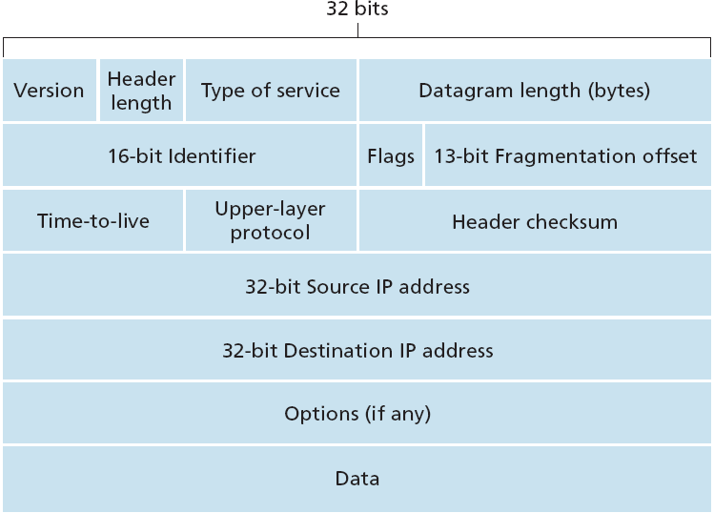
IP datagram format
20 bytes
fixed
upto
40 bytes

Slide 21
IP header fields
Version - 4 bit
  `4` for IPv4
  `6` for IPv6
  host/router determines
  how to interpret
  datagram
Header Length - 4 bit
  in 32 bit words
  variable (20 – 60 bytes),
  due to variable number
  of options
  min (typical) value is `5` for 20 byte header (without options)
Notes:
Version (4 bits): Indicates version number, to allow evolution of the protocol; the value is 4.
Internet Header Length (IHL) (4 bits): Length of header in 32-bit words. The minimum value is five, for a minimum header length of 20 octets.
DS/ECN (8 bits): Prior to the introduction of differentiated services, this field was referred to as the Type of Service field and specified reliability, precedence, delay, and throughput parameters. This interpretation has now been superseded. The first six bits of this field are now referred to as the DS (differentiated services) field, discussed in Chapter 19. The remaining 2 bits are reserved for an ECN (explicit congestion notification) field, currently in the process of standardization. The ECN field provides for explicit signaling of congestion in a manner similar to that discussed for frame relay (Section 13.5).
Total Length (16 bits): Total datagram length, including header plus data, in octets.

Slide 22
IP header fields
TOS - 8 bit
  meant to mark pkt priority,
  for different service types
  distinguishes IP datagrams
  (requiring low delay,
  high throughput, or
  reliability)
Total Length - 16 bit
  datagram length in bytes (header + data)
  theoretical max is 65,535 bytes; but rarely larger than 1,500 bytes
Notes:
Version (4 bits): Indicates version number, to allow evolution of the protocol; the value is 4.
Internet Header Length (IHL) (4 bits): Length of header in 32-bit words. The minimum value is five, for a minimum header length of 20 octets.
DS/ECN (8 bits): Prior to the introduction of differentiated services, this field was referred to as the Type of Service field and specified reliability, precedence, delay, and throughput parameters. This interpretation has now been superseded. The first six bits of this field are now referred to as the DS (differentiated services) field, discussed in Chapter 19. The remaining 2 bits are reserved for an ECN (explicit congestion notification) field, currently in the process of standardization. The ECN field provides for explicit signaling of congestion in a manner similar to that discussed for frame relay (Section 13.5).
Total Length (16 bits): Total datagram length, including header plus data, in octets.

Slide 23
IP header fields
16 bit Identification
  sequence number, used in fragmentation
  uniquely identifies datagram (along with src/dest IP addrs, & protocol)
3 bit Flags
  1 bit Reserved (not used)
  Don’t Fragment bit : prohibits fragmentation
  More bit : used for fragmentation & re-assembly
    `0’ marks last fragment
13 bit Fragmentation Offset
  indicates where in original datagram the fragment belongs
  measured in 64 bit units (8 bytes)
  implies that fragments other than the last must contain a data field that is multiple of 64 bits
Notes:
Version (4 bits): Indicates version number, to allow evolution of the protocol; the value is 4.
Internet Header Length (IHL) (4 bits): Length of header in 32-bit words. The minimum value is five, for a minimum header length of 20 octets.
DS/ECN (8 bits): Prior to the introduction of differentiated services, this field was referred to as the Type of Service field and specified reliability, precedence, delay, and throughput parameters. This interpretation has now been superseded. The first six bits of this field are now referred to as the DS (differentiated services) field, discussed in Chapter 19. The remaining 2 bits are reserved for an ECN (explicit congestion notification) field, currently in the process of standardization. The ECN field provides for explicit signaling of congestion in a manner similar to that discussed for frame relay (Section 13.5).
Total Length (16 bits): Total datagram length, including header plus data, in octets.

Slide 24
IP header fields
8 bit Time to Live
  max hop count that packet can
  remain in Internet (default 64)
  each router decrements TTL
  by 1
  when TTL = 0, router discards
  datagram
  ensures datagrams do not
  circulate forever (routing loops)
8 bit Protocol
  indicates transport layer protocol to receive data; TCP=6, UDP=17
  used when datagram reaches final dest
  de-mux key
Notes:
Version (4 bits): Indicates version number, to allow evolution of the protocol; the value is 4.
Internet Header Length (IHL) (4 bits): Length of header in 32-bit words. The minimum value is five, for a minimum header length of 20 octets.
DS/ECN (8 bits): Prior to the introduction of differentiated services, this field was referred to as the Type of Service field and specified reliability, precedence, delay, and throughput parameters. This interpretation has now been superseded. The first six bits of this field are now referred to as the DS (differentiated services) field, discussed in Chapter 19. The remaining 2 bits are reserved for an ECN (explicit congestion notification) field, currently in the process of standardization. The ECN field provides for explicit signaling of congestion in a manner similar to that discussed for frame relay (Section 13.5).
Total Length (16 bits): Total datagram length, including header plus data, in octets.

Slide 25
IP header fields
Header Checksum - 16 bit
  error detection code applied only
  to IP hdr
  (detect bit errors in recvd hdr)
  Checksum computation:
  Treat each 2 bytes in hdr as
  16 bit integers
  Take sum using 1s complement arithmetic
  Then take 1s complement of sum
  routers verify & re-compute checksum for each received datagram
  Error condition: if computed checksum does not match the checksum received in hdr, datagram discarded
Notes:
Version (4 bits): Indicates version number, to allow evolution of the protocol; the value is 4.
Internet Header Length (IHL) (4 bits): Length of header in 32-bit words. The minimum value is five, for a minimum header length of 20 octets.
DS/ECN (8 bits): Prior to the introduction of differentiated services, this field was referred to as the Type of Service field and specified reliability, precedence, delay, and throughput parameters. This interpretation has now been superseded. The first six bits of this field are now referred to as the DS (differentiated services) field, discussed in Chapter 19. The remaining 2 bits are reserved for an ECN (explicit congestion notification) field, currently in the process of standardization. The ECN field provides for explicit signaling of congestion in a manner similar to that discussed for frame relay (Section 13.5).
Total Length (16 bits): Total datagram length, including header plus data, in octets.

Slide 26
IP header fields
Source IP & Destination IP
Addresses
  32 bit addresses
  when source creates datagram,
  IP addrs inserted into
  relevant fields
Options
  variable length, max 40 bytes
  options requested by sender
  e.g, timestamp, record route taken, source routing, etc
  options used rarely — reduces overhead by not including options fields in every datagram
Notes:
Version (4 bits): Indicates version number, to allow evolution of the protocol; the value is 4.
Internet Header Length (IHL) (4 bits): Length of header in 32-bit words. The minimum value is five, for a minimum header length of 20 octets.
DS/ECN (8 bits): Prior to the introduction of differentiated services, this field was referred to as the Type of Service field and specified reliability, precedence, delay, and throughput parameters. This interpretation has now been superseded. The first six bits of this field are now referred to as the DS (differentiated services) field, discussed in Chapter 19. The remaining 2 bits are reserved for an ECN (explicit congestion notification) field, currently in the process of standardization. The ECN field provides for explicit signaling of congestion in a manner similar to that discussed for frame relay (Section 13.5).
Total Length (16 bits): Total datagram length, including header plus data, in octets.

Slide 27
IP header fields
Padding
  to fill to multiple of 32 bits long
Data Field
  carries transport layer segment
  (TCP or UDP)
  can also carry other types of data,
  such as ICMP messages
  integer multiple of 8 bits long
  (bytes)
Notes:
Version (4 bits): Indicates version number, to allow evolution of the protocol; the value is 4.
Internet Header Length (IHL) (4 bits): Length of header in 32-bit words. The minimum value is five, for a minimum header length of 20 octets.
DS/ECN (8 bits): Prior to the introduction of differentiated services, this field was referred to as the Type of Service field and specified reliability, precedence, delay, and throughput parameters. This interpretation has now been superseded. The first six bits of this field are now referred to as the DS (differentiated services) field, discussed in Chapter 19. The remaining 2 bits are reserved for an ECN (explicit congestion notification) field, currently in the process of standardization. The ECN field provides for explicit signaling of congestion in a manner similar to that discussed for frame relay (Section 13.5).
Total Length (16 bits): Total datagram length, including header plus data, in octets.

Slide 28
IP fragmentation, reassembly
network link has an MTU (max transfer unit) - largest size IP pkt it can carry
  different links, different MTUs (Ethernet: 1500 bytes)
larger IP datagrams divided (“fragmented”) by routers
  one datagram becomes several datagrams
  “reassembled” only at final destination
  IP header bits used to identify & re-order, related fragments
Fragmentation:
in: one large datagram
out: 3 smaller datagrams
…
reassembly
…

Slide 29
IP fragmentation, reassembly
Datagram of 4,000 bytes (20 bytes of IP header plus 3,980 bytes of IP payload) arrives at a router and must be forwarded to a link with MTU of 1,500 bytes
Implies that 3,980 IP payload data bytes in original datagram must be allocated to three separate fragments
(each of which is also an IP datagram)
Amount of payload data, in all but the last fragment, should be a multiple of 8 bytes, and offset value should be specified in units of 8-byte chunks
If original datagram is stamped with identification number 777, header field values of 03 fragments are shown in next slide…

Slide 30
IP fragmentation, reassembly
example…
4000 byte datagram
MTU = 1500 bytes
X = 777
length
=4000
ID
=x
More flag
=0
offset
=0
one large datagram becomes
several smaller datagrams
1480 bytes in
data field
length
=1500
ID
=x
More flag
=1
offset
=0
offset =
1480/8
length
=1500
ID
=x
More flag
=1
offset
=185
length
=1040
ID
=x
More flag
=0
offset
=370

Slide 31
IP fragmentation, reassembly
When router needs to fragment an IP datagram, each resulting fragment is stamped with source address, destination address, and identification number of original datagram
When destination receives a series of datagrams from the same sending host, it can examine ‘identification’ numbers of datagrams to determine which datagrams are actually fragments of the same larger datagram
Because IP is an unreliable service, one or more fragments may never arrive at destination; all other fragments would need to be dropped

Slide 32
IP fragmentation, reassembly
In order for destination host to be absolutely sure it has received the last fragment of original datagram, the last fragment has ‘More’ flag bit set to 0, whereas all other fragments have this flag bit set to 1
To allow destination host to reassemble fragments in their proper order, the ‘Offset’ field is used to specify where the fragment fits within the original IP datagram;
‘Offset’ field also helps to determine whether some fragment is missing

